Slide 1
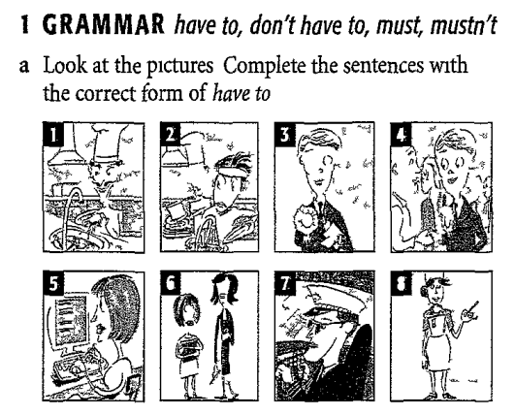
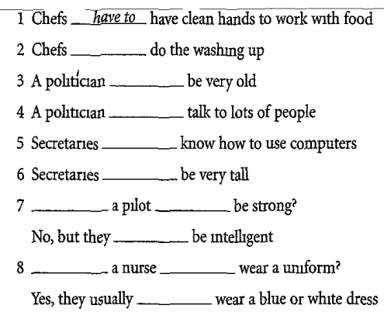

Slide 2
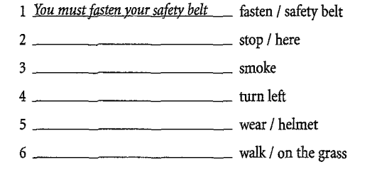
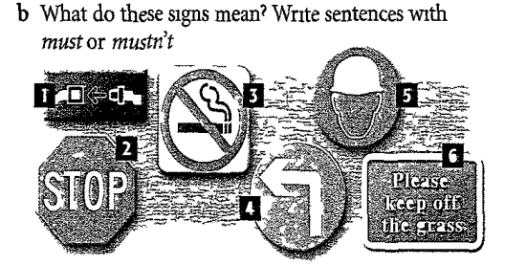

Slide 3
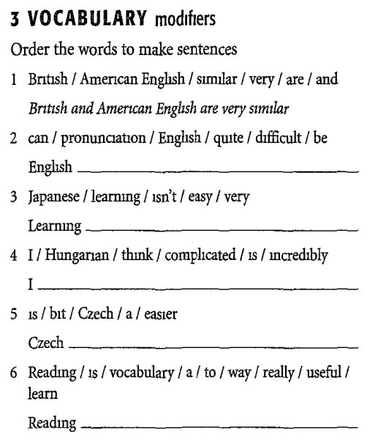
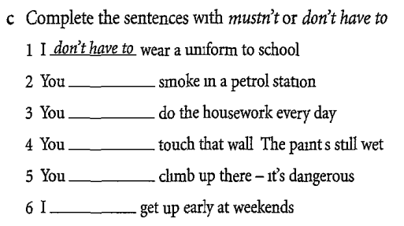

Slide 4
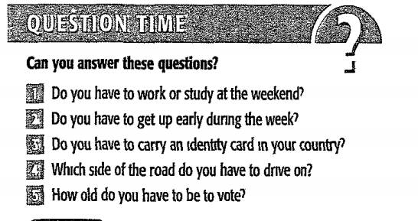

Slide 5
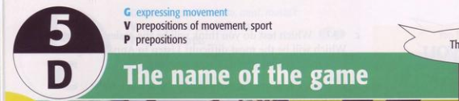
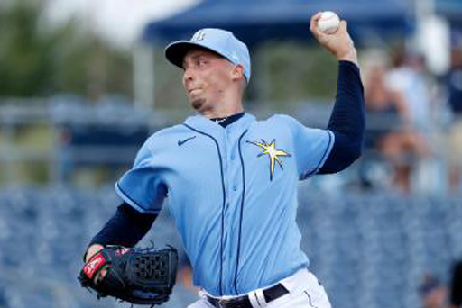
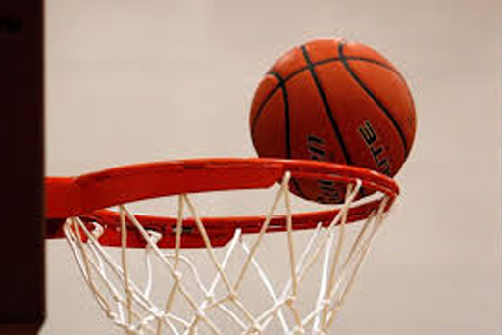
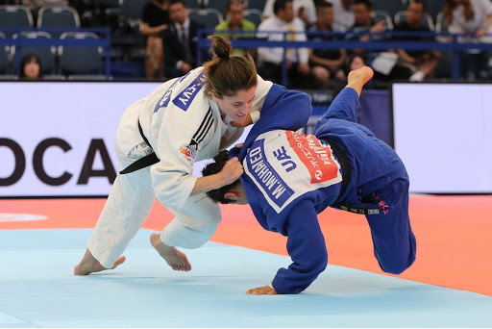
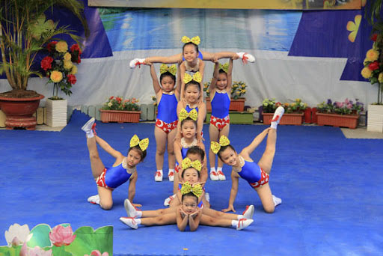

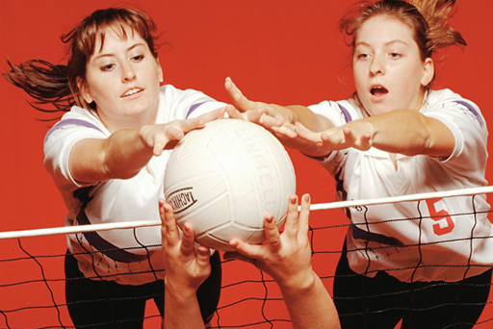
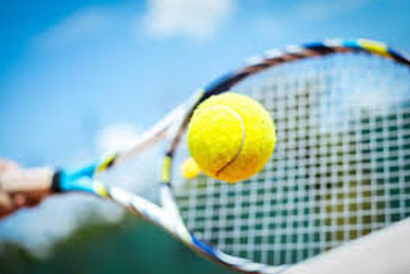
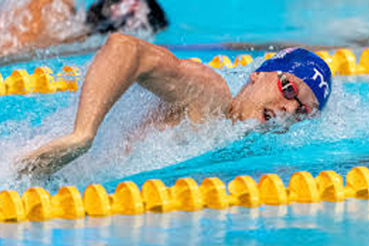
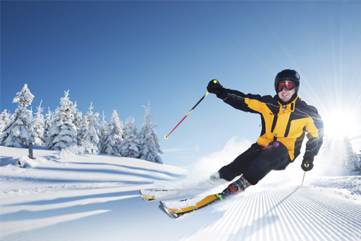
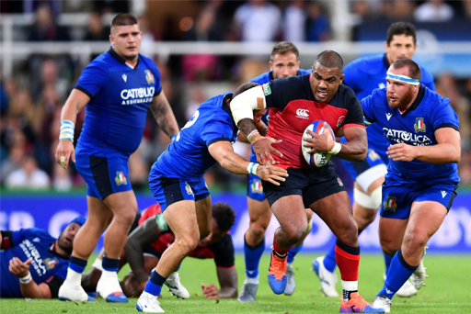
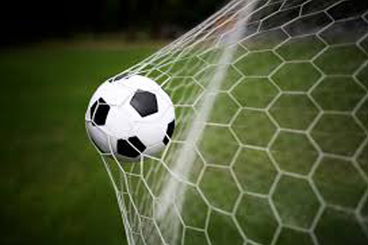
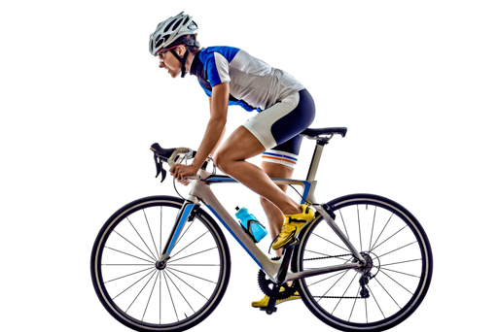
1. Vocabulary & speaking
baseball
basketball
Look at the photos. Can you name the sports.
judo
aerobic
golf
volleyball
tennis
swimming
skiing
rugby
football
cycling

Slide 6
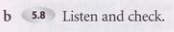

Play
Go
Do
Golf /gɒlf/
Football
Tennis
Rugby /’rʌgbi/
Basketball /‘bɒ:skitbɔ:l/
Volleyball /’vɔlibɔ:l/
Baseball /‘beisbɔ:l/
Skiing
Swimming
Cycling /’saikliη/
Judo /’dʒu:dou/
Aerobics /eə’rəbiks/

Slide 7
Notes:
Use “play” with sports with a ball
Use “go” with sports that end in “ing”
Use “do” with martial arts and activities that you do in gym

Slide 8
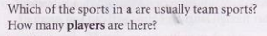
c. In pair, say…
Teams sport
Players
Baseball
Basketball
Football
Rugby union
Volleyball
9
5
11
15
6

Slide 9
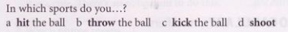
a. You “hit” the ball in baseball, tennis and volleyball
b. You “throw” the ball in baseball, basketball and rugby
c. You “kick” the ball in football and rugby
d. You “shoot” in basketball anf football

Slide 10
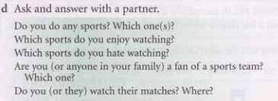

Slide 11
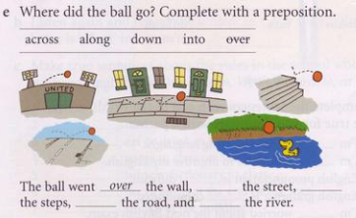
along
down
across
into

Slide 12
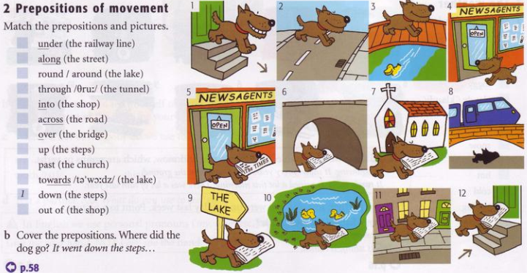
8
11
10
6
4
2
3
12
7
9
5

Slide 13
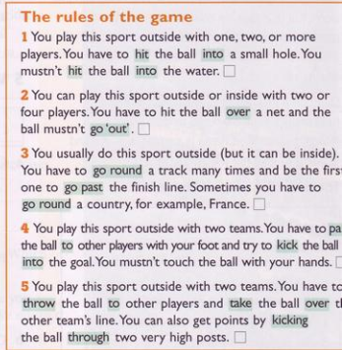
2. GRAMMAR: expressing movement
a. Match the rule to the sports in 1. What are the sports?
golf
tennis
t
t
b. Listen and check.
cycling
ss
football
he
rugby

Slide 14
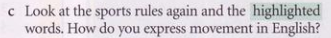
Hit into/over
Go out/around/ pass/to
Kich into
Throw to
Take over
Kicking throughpass
To express movement use a verb of movement (go, come, run, walk…) and a preposition of movement (up, down etc.)
Ex: The man went up the steps and into the church.
I ran over the bridge and across the park.
He drove out of the garage and along the street.
Notes:
Go out

Slide 15
NOTE:
Be careful with in/into and out/ out of.
Use into/ out of + noun, but if there isn’t a noun just use in or out.
Ex: Come into the living room. Come in.
He went out of the house. He went out.

Slide 16
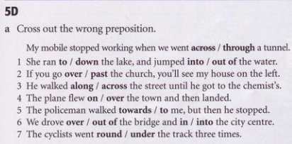
Exercises (p.134)

Slide 17
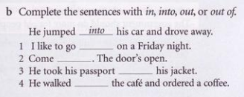
out
in
out of
into

Slide 18
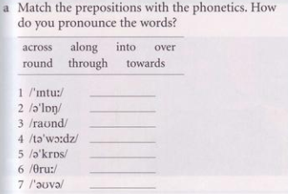
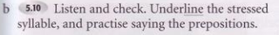
3. PRONUNCIATION: prepositions
into
along
round
toward
across
though
over

Slide 19
4. READING & SPEAKING
a. How long does a normal football match last?
A normal football match lasts 90 minutes.
- How many minutes are added after each half?
It depends on the situation of a match
Time is added for time lost because of injuries, etc…

Slide 20
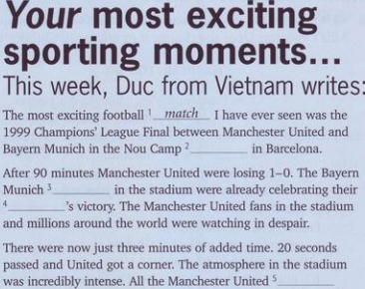
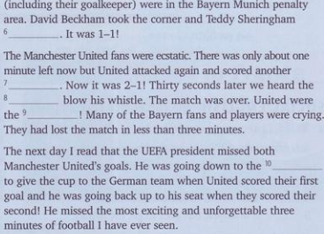
b. Read the article and complete with a word from below.
champions fans goal match pitch
players referee scored stadium team
scored
goal
referee
stadium
champions
fans
team
pitch
players

Slide 21
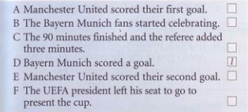
5
2
3
6
4

Slide 22
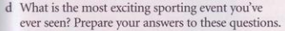
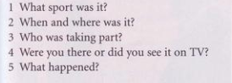
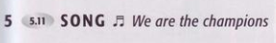

Slide 23
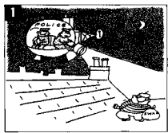
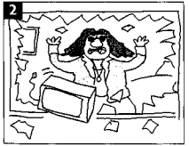
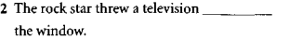
Exercises
out of

Slide 24
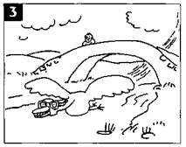
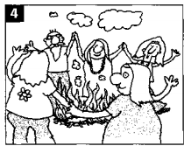
under
round

Slide 25
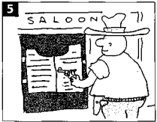
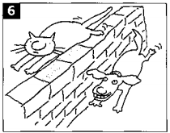
towards
along

Slide 26
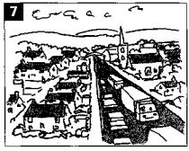
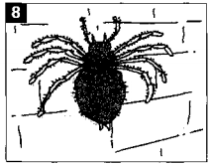
though
up

Slide 27
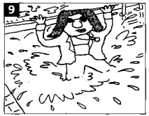
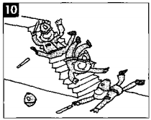
into
down

Slide 28
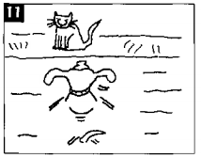
across

